Slide 1
How to Build an Industry Cost Profile (ICP) for a product in the U.S.A.
Select the Industry Code Based on the Supplier’s Business and Product
Step 2
Identify Data Sources for Financial and Manufacturing Information Related to Industry Code
Step 3
Use Financial Data to Calculate Ratios for COGS, PBT, GSA & Other Expenses
Step 4
Use Manufacturing Data to Calculate Ratios for DM, DL, and MOH
Step 1

Slide 2
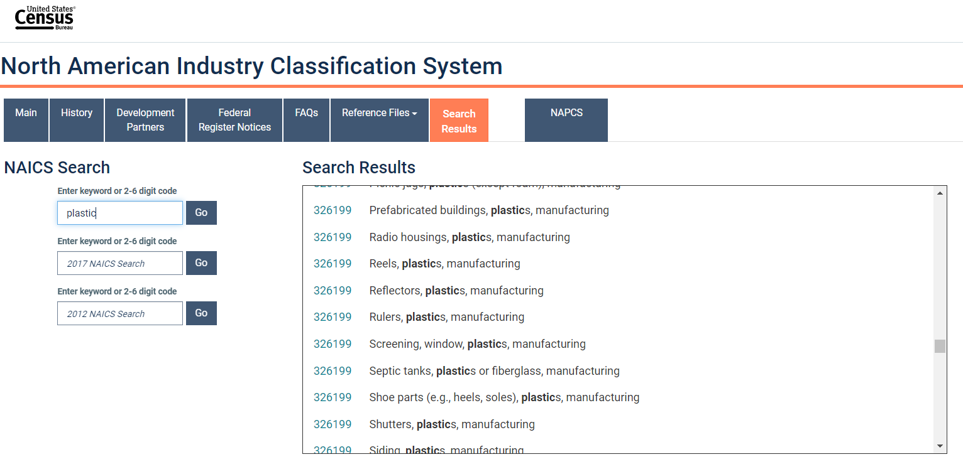
Select the Industry Code Based on the Supplier’s Business and Product
Step 1
Go to:
Conduct a word search to find possible NAICS codes for the product
Select the NAICS code with the best match and record for later use
https://www.census.gov/naics/
Tip: click on the code to view its full definition

Slide 3
Identify Data Sources for Financial and Manufacturing Information Related to Industry Code
Step 2
U.S. Government economic statistics are found at:
Financial data of companies can be found at:
 | Direct Material (DM)
 | Direct Labor (DL)
 | Manufacturing Overhead (MOH)
 | Cost of Goods Sold (COGS)
 | GSA & Other Expenses
 | Profit Before Tax (PBT)
 | Total Sales
Manufacturing data
Source: U.S. Government economic statistics
census.gov
Financial data
Source: Financial reports of companies
sec.gov/edgar.shtml
*You will use these data sources to express DM, DL, MOH, COGS, GSA & Other Expenses and PBT as ratios, in the form of percentages of Total Sales.

Slide 4
Use Financial Data to Calculate Ratios for COGS, PBT, GSA & Other
Step 3
From each firms’ Income Statement, use multiple year averages to calculate COGS, GSA & Other Expenses and PBT.
Use as many firms as you judge necessary to get an accurate representation of the industry you are modelling.
Core Molding Technologies (CMT)*
 |  | 2020 | 2019 | 2018 | Average
 | COGS | 81.7% | 82.8% | 83.6% | 82.7%
 | GSA & Other | 9.2% | 8.9% | 9.5% | 9.2%
 | PBT | 9.1% | 8.3% | 6.9% | 8.1%
 | Total Sales | 100% | 100% | 100% | 100%
*Example firm operating in the Plastics Product Manufacturing Industry
$$COGS \%=\frac{COGS}{Total Sales}$$
$$PBT \%=\frac{PBT}{Total Sales}$$
GSA & O. Exp. % = Total sales (100%) – COGS % – PBT %

Slide 5
Use Financial Data to Calculate Ratios for COGS, PBT, GSA & Other
Step 3
Average the ratios of the selected firms to create your industry ratios.
Selected firms in Plastics product manufacturing industry*
 |  | Firm 1 | Firm 2 | … | Firm 7 | Average
 | COGS | 82.7% | 81% | … | 83% | 82.2%
 | GSA & Other | 9.2% | 10% | … | 9% | 9.4%
 | PBT | 8.1% | 9% | … | 8% | 8.4%
 | Total Sales | 100% | 100% | … | 100% | 100%
*Example data for illustration purposes only

Slide 6
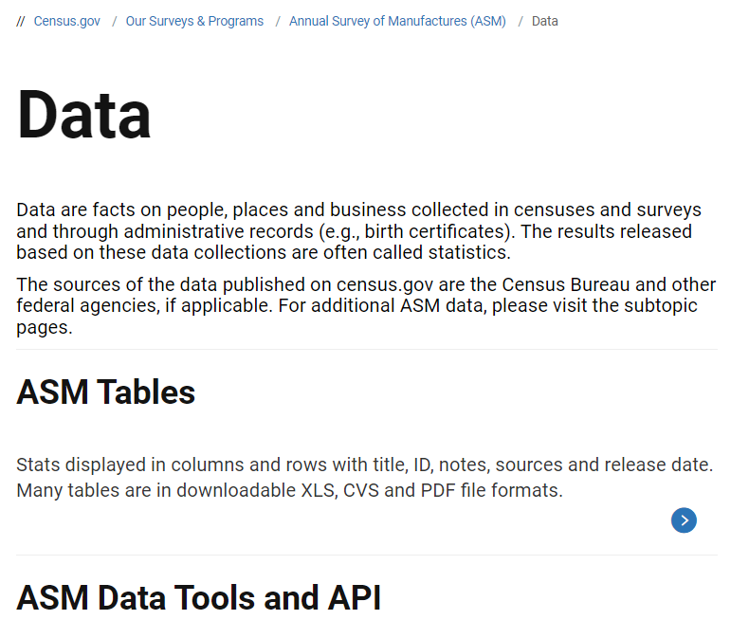
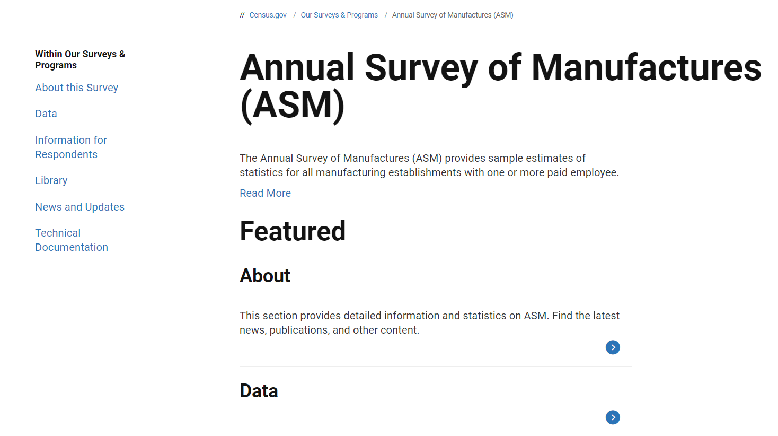
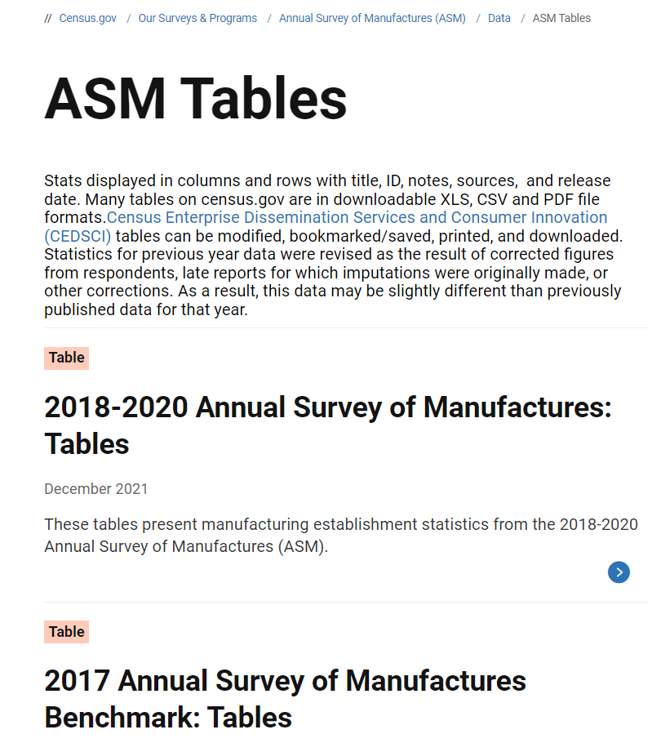
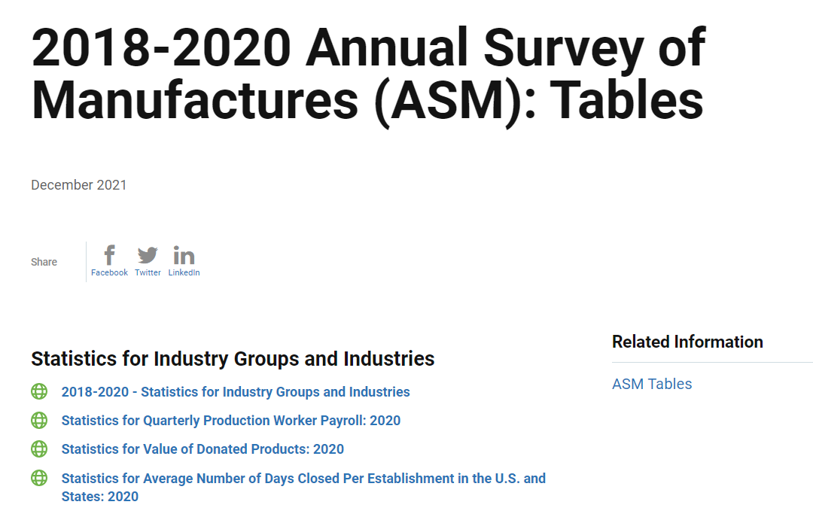
Obtain the latest available Economic Census data from the US Bureau of Census for the industry of interest
Step 2
Go to:
Select SURVEYS and click on Annual Survey of Manufactures (ASM)
Select Data and click on ASM Tables.
Select the ASM for the desired period and select “2018-2020 - Statistics for Industry Groups and Industries”
www.census.gov

Slide 7
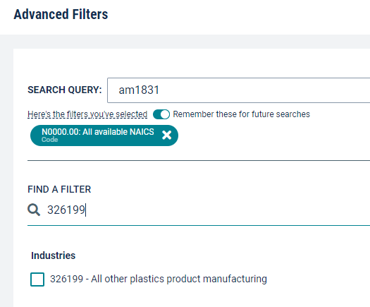
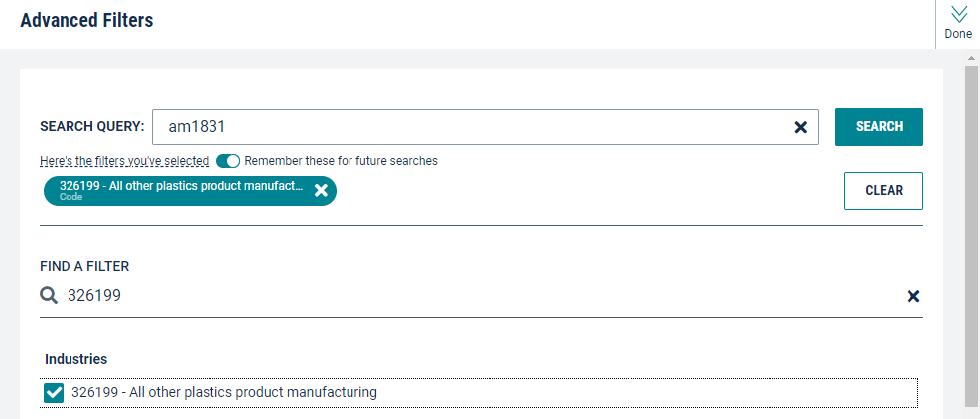
Obtain the latest available Economic Census data from the US Bureau of Census for the industry of interest
Step 3
Remove the default filter (All available NAICS).
Enter the industry code of interest, or use keywords if unknown.
Select desired code(s) and click Done in the top right of the table.

Slide 8
Use Manufacturing Data to Calculate Ratios for DM, DL, and MOH
Step 4
Click on CUSTOMIZE TABLE on the right and then click on Download.

Slide 9
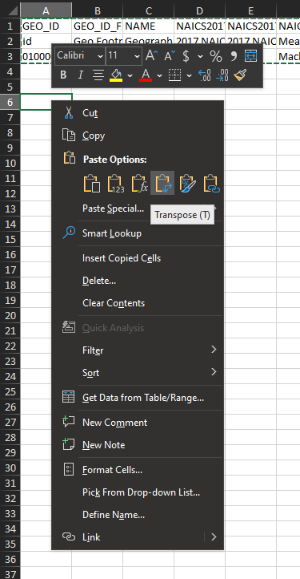
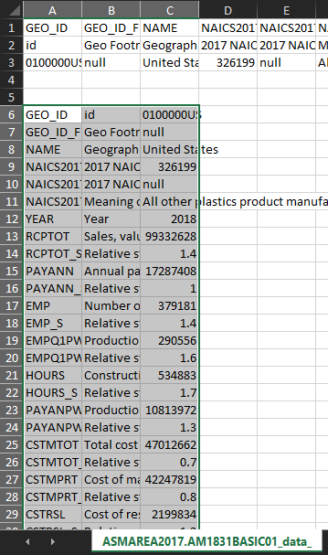
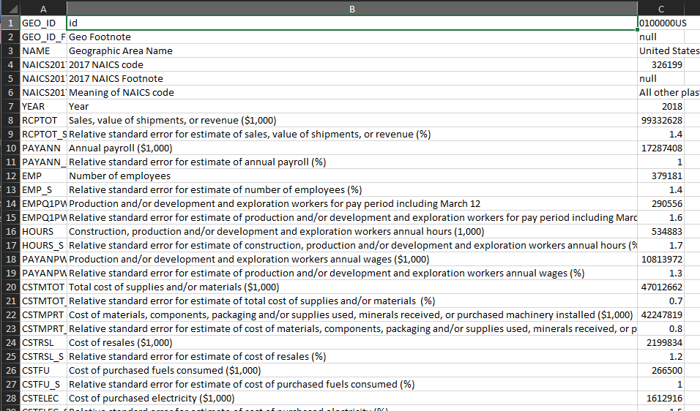
Use Manufacturing Data to Calculate Ratios for DM, DL, and MOH
Step 4
Open the first file in the zip folder (“data_with-overlays”). It should open in MS Excel.
Select the first three rows and select Copy (Ctrl+C).
Transpose-Paste in a cell below.
Make column B wider in order to see the full text.

Slide 10
Use Manufacturing Data to Calculate Ratios for DM, DL, and MOH
Step 4
Record figures for:
- Sales, value of shipments, or revenue
- Production and/or development and exploration workers annual wages
- Total cost of supplies and/or materials
- Cost of purchased fuels consumed
- Cost of purchased electricity

Slide 11
Use Manufacturing Data to Calculate Ratios for DM, DL, and MOH
Step 4
Remove Cost of purchased electricity and Cost of purchased fuels from Total cost of materials
Calculate the DM ratio as percentage of Total value of shipments (We use this value for Total Sales)
 | Total cost of supplies / materials | 47,012,662
 | less Cost of purchased electricity | 1,612,916
 | less Cost purchased fuels | 266,500
 | Cost of Materials (adjusted) | 45,133,246
 | Cost of materials (adjusted) | 45,133,246
 | Sales, value of shipments, or revenues | 99,332,628
 | Direct Material (DM) | 45.4%

Slide 12
Use Manufacturing Data to Calculate Ratios for DM, DL, and MOH
Step 4
Calculate the DL ratio as percentage of Total value of shipments
Calculate MOH by deduction as follows:
 | Production workers annual wages | 10,813,972
 | Total value of shipments (Total Sales) | 99,332,628
 | Direct Labor (DL) | 10.9%
 | Cost of Goods Sold (COGS) | 82.2%
 | less Direct Material (DM) | 45.4%
 | less Direct Labor (DL) | 10.9%
 | Manufacturing Overhead (MOH) | 25.9%
MOH = COGS – DM –DL

Slide 13
Present all your calculated ratios in the cost breakdown format
Industry cost profile for “Plastics product manufacturing”
 | Direct Material (DM) | 45.4%
 | Direct Labor (DL) | 10.9%
 | Manufacturing Overhead (MOH) | 25.9%
 | Cost of Goods Sold (COGS) | 82.2%
 | GSA & Other Expenses | 9.4%
 | Profit Before Tax (PBT) | 8.4%
 | Total Sales | 100.0%
Ratios calculated from U.S. government economic statistics
Ratios calculated from companies’ financial data

Slide 14
References and summary of ICP calculations
Cost Element | % of Sales | Calculation | Order
DM | 45.4% | = (F - D - E) / G | 4
DL | 10.9% | = C / G | 5
MOH | 25.9% | = COGS - DM - DL | 6
COGS | 82.2% | = A | 1
GSA | 9.4% | = Total - COGS - PBT | 3
PBT | 8.4% | = B | 2
TOTAL | 100.0%
SUMMARY OF DATA
 | Data point | Value | Source
A | Cost of Goods Sold | 82.2% | Average of representative firm's financials
B | Profit Before Tax | 8.4% | Average of representative firm's financials
C | Production workers annual wages | 10,813,972 | U.S. Census Bureau, 2018 Annual Survey of Manufactures: NAICS 326199
D | Cost of purchased fuels consumed | 266,500 | U.S. Census Bureau, 2018 Annual Survey of Manufactures: NAICS 326199
E | Cost of purchased electricity | 1,612,916 | U.S. Census Bureau, 2018 Annual Survey of Manufactures: NAICS 326199
F | Total cost of supplies / materials | 47,012,662 | U.S. Census Bureau, 2018 Annual Survey of Manufactures: NAICS 326199
G | Sales, value of shipments, or revenues | 94,674,120 | U.S. Census Bureau, 2018 Annual Survey of Manufactures: NAICS 326199

